Slide 1
Social media and Graphs
Dr. Kyle Goslin

Slide 2
Introduction
One of the more recent sources of data is social media streams. These streams provide up to date news or commentary about one or many different topics.
This provides us with a unique opportunity to begin processing in real time.
When working with social media, we have a different collection of challenges as the text is often very short. If performing term weighting, this puts additional emphasis on terms that may not be correct. For this reason additional care must be taken.

Slide 3
Twitter
To start, we will look at gathering data from the Twitter API.
A number of different language specific libraries exist, and for each language there is even more libraries. To narrow this down we will look at the following library: https://github.com/bear/python-twitter
The installation for this library can be performed using pip.
pip install python-twitter

Slide 4
Twitter API
Before you begin working with twitter data, a new app must be created to get a set of keys for the API.
https://developer.twitter.com/en/apps

Slide 5
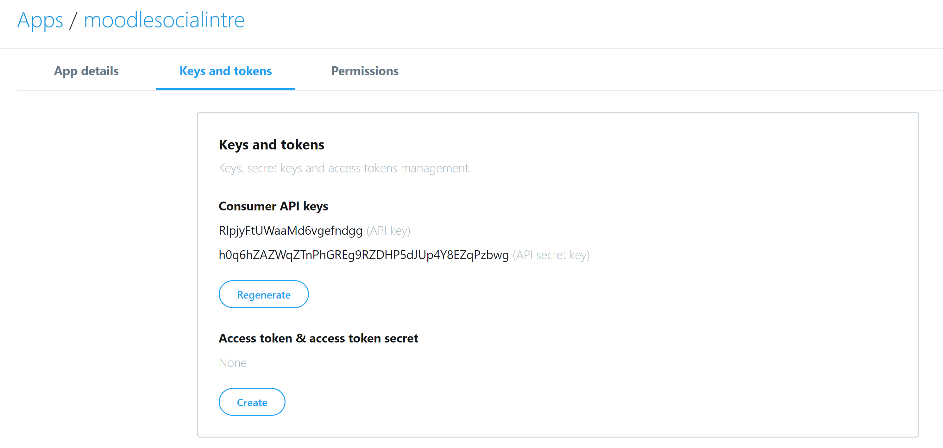
Twitter API

Slide 6
Twitter – Getting tweets (1/2)
import twitter
import random
api = twitter.Api(consumer_key='1wUmYQ6c2GQFh7j7CIYhyaJ6R',
consumer_secret='yPHBqqT9o1lppggiscju0yAjutRclS6sOVysh0rFXKTgFE20F3',
access_token_key='14848455-e9sJlUc3GORp6tKC6B2fCEgF2T7pJABO8M30DShfy',
access_token_secret='37ykBWjxkYHxPlEhOlTa6RDnpoIJqCFOLT0cqzYbEQoP0')
print(api.VerifyCredentials())

Slide 7
Twitter – Getting tweets (2/2)
useracc = 'BarackObama'
num = random.randint(1, 1000)
f = open(useracc+'_'+str(num)+'.txt', 'w')
statuses = api.GetUserTimeline(screen_name=useracc, count='200')
for s in statuses:
tx = s.text.encode("ascii", errors='ignore')
print(tx)
f.write(str(tx) + '\n')
f.close()

Slide 8
Twitter
This code sample is designed to pull down the individual tweets and put them into a text file.
There is a limited number of requests that can be made to the twitter API. If we place the content into a text file we can perform offline processing ourselves without recalling the API.

Slide 9
Searching Twitter (1/3)
import twitter
import random
import json
api = twitter.Api(consumer_key='1wUmYQ6c2GQFh7j7CIYhyaJ6R',
consumer_secret='yPHBqqT9o1lppggiscju0yAjutRclS6sOVysh0rFXKTgFE20F3',
access_token_key='14848455-e9sJlUc3GORp6tKC6B2fCEgF2T7pJABO8M30DShfy',
access_token_secret='37ykBWjxkYHxPlEhOlTa6RDnpoIJqCFOLT0cqzYbEQoP0')

Slide 10
Searching Twitter (3/3)
def searchTwiter(q):
countscore = 0
results = api.GetSearch(raw_query="q="+str(q)+"&result_type=recent&since=2014-07-19&count=100")
keywords = list()
keywords.append('range ')
keywords.append('products ')
keywords.append('order ')
keywords.append('shipping ')
keywords.append('shipped ')
keywords.append('win ')
keywords.append('book ')
js = str(results)

Slide 11
Searching Twitter (3/3)
f = open('searchtestoutput.txt', 'w')
for xx in results:
tx = xx.text.encode("ascii", errors='ignore').lower()
f.write(str(tx) + '\n')
for key in keywords:
if key in str(tx).lower():
countscore = countscore + 1
f.close()
return countscore
print(searchTwiter("cordiallyinvited"))

Slide 12
Metrics of importance
When working with social data, our metrics to identify if a piece of text is useful to us or not is different to other approaches such as TF-IDF.
The “freshness” of the text plays a role, the timestamp can be used as a filter to get tweets in a time window of 10 mins, 20 mins, etc. After a period of maybe 12 hours the text may no longer be relevant.
The number interactions a tweet can have also plays a role to identify the important of a tweet. The high the comments, likes etc, the higher ranked the text should be.

Slide 13
VisJS
Link: http://visjs.org
Installation: Zip file download
Folder: vis-4.21.0\vis-4.21.0\examples\network\exampleApplications
lesMiserables.html

Slide 14
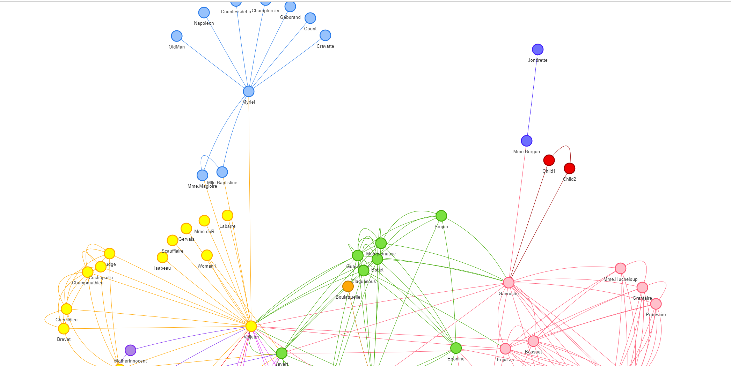
Network Graph

Slide 15
This graph contains two core components, the nodes and edges.
When viewing any visualisation such as this example, we want to look for the pattern in the source code to see how the nodes and edges are being created.
Once we figure out how it is created, we can then use Python to replicate this process for live real data.

Slide 16
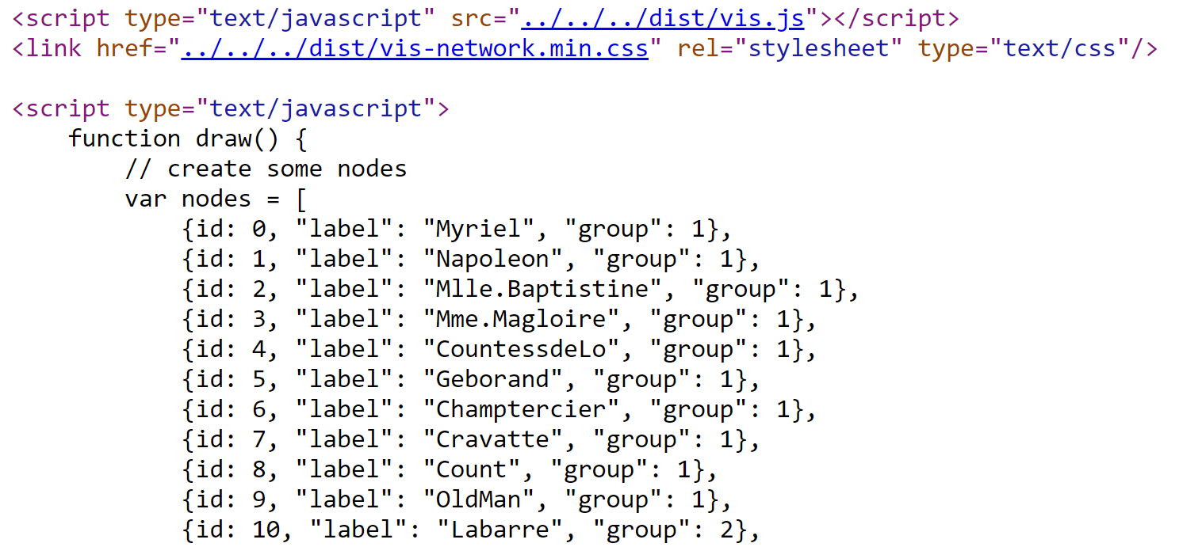
Nodes

Slide 17
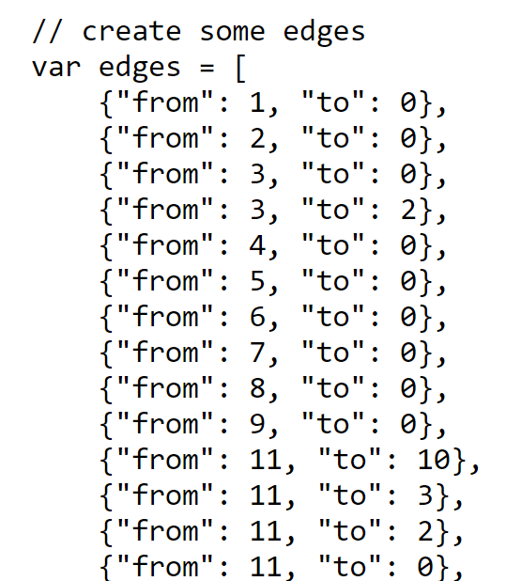
Edges – Links between the nodes

Slide 18
Applying this to twitter data
If we consider a twitter feed for a single user, each individual tweet can be a node.
Each person who comments or likes the tweet can then be a node that is connected via an edge.

Slide 19
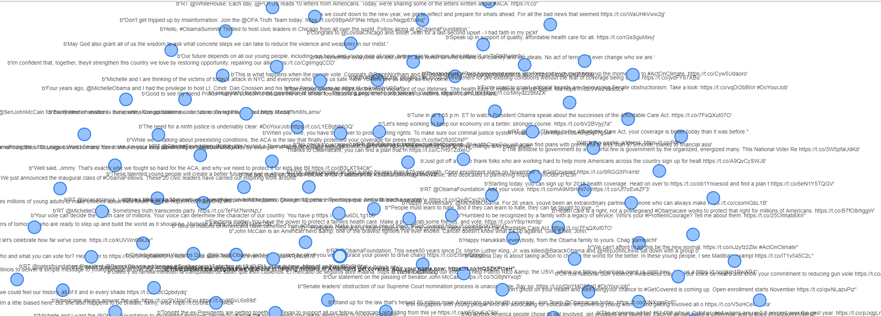
One node per tweet

Slide 20
Selecting relevant text
After the nodes have been created the edges between the nodes must be created.
Some criteria needs to be outlined as to what will be the metric for connecting individual tweets.
We can connect tweets based on:
Words that are the same in different tweets
Words that are of interest in different tweets

Slide 21
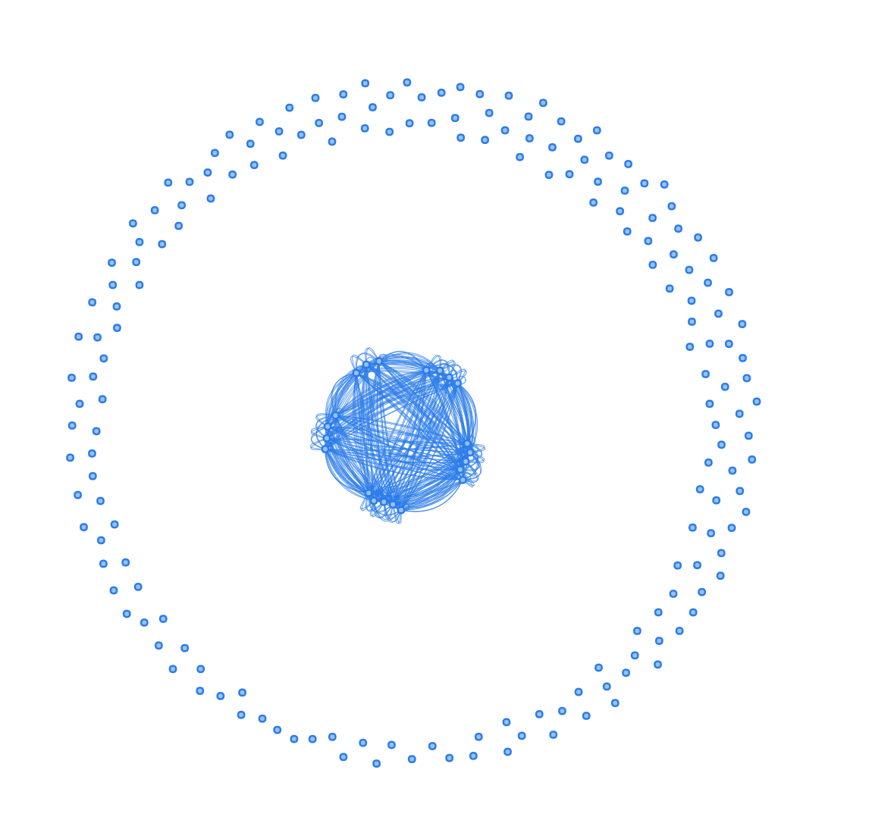
Zoomed out
All the irrelevant tweets are around the edge of the circle.

Slide 22
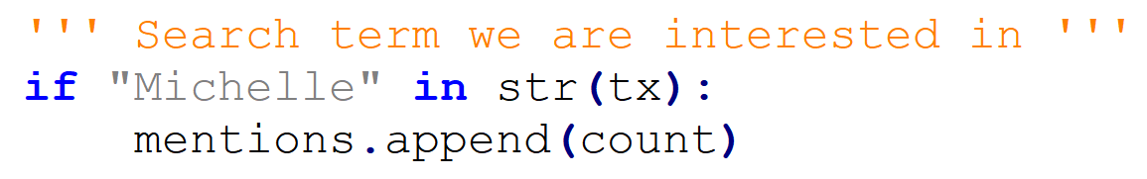

Slide 23
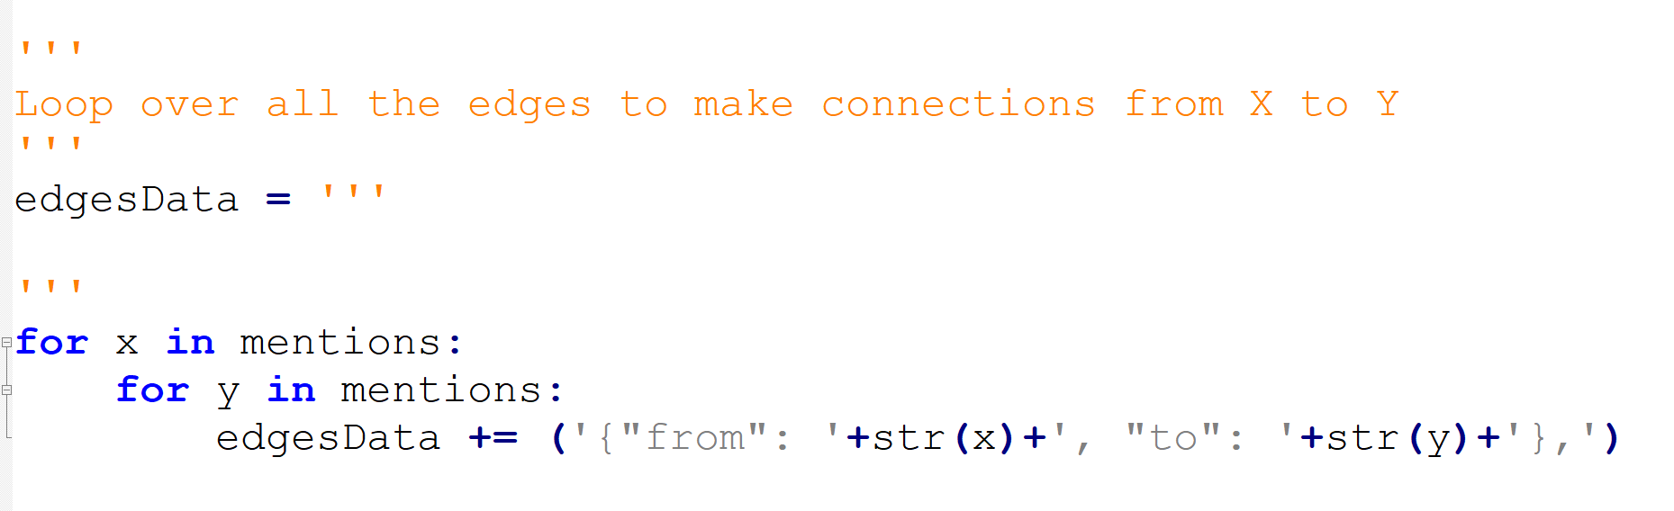
Creating connections between all tweets
All selected tweets are connected via edges.

Slide 24
Timestamp
statuses = api.GetUserTimeline(screen_name=useracc, count='200')
for s in statuses:
print(s.created_at)
Returns back: Wed Oct 19 15:09:17 +0000 2016

Slide 25
Timestamp format
from datetime import datetime
tweet_timestamp = datetime.strptime(tweet.created_at, "%a %b %d %H:%M:%S +0000 %Y")

Slide 26
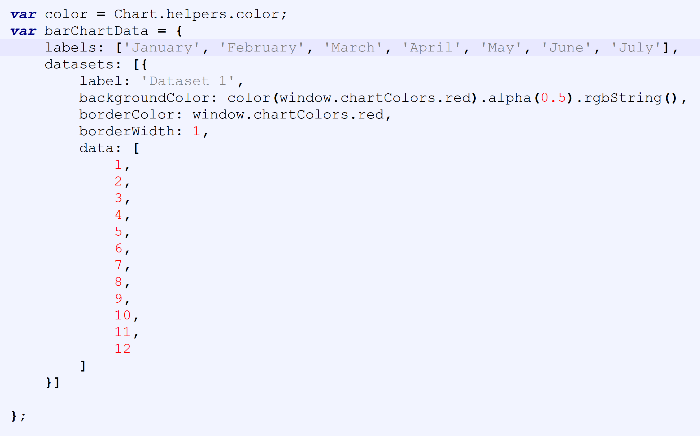
Bar Graph – Looking for the X and Y

